Slide 1





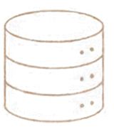
CAMPUS FACILITY MAINTENANCE MANAGEMENT SYSTEM
A Database-Driven Web Application for
Managing Campus Maintenance Requests
DBMS Course Project
Pranav Arjun Nikam • Purva • Sharanya • Saathvik
Dr. Kiran Mayee Adavala

Slide 2









THE PROBLEM
Maintenance requests are difficult to manage when information is scattered across people, messages and manual records.
REQUEST
01
Requests are difficult to track
MANUAL COMMUNICATION
02
Technician assignment is not centralized
TECHNICIAN
03
Work and material records are scattered
REPAIR
UNCLEAR HISTORY
04
Reporting becomes difficult

Slide 3

















ONE SYSTEM. ONE WORKFLOW.
A centralized database-driven platform for the complete maintenance lifecycle.
CREATE REQUEST
PRIORITIZE
ASSIGN
REPAIR
CLOSE
FEEDBACK
REPORT
Centralized Data
Real-Time Status
Technician Management
Structured Reporting

Slide 4











HOW THE SYSTEM WORKS
USER
FRONTEND
HTML
CSS
WEB INTERFACE
JavaScript
HTML • CSS • JavaScript • Jinja2
Jinja2
FLASK APPLICATION
BACKEND
Python
Flask
MYSQL CONNECTOR
DATABASE
MYSQL DATABASE
MySQL 8.0
campus_maintenance

Slide 5

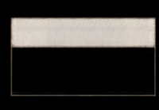


















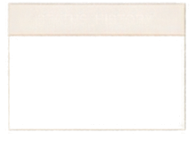



THE DATABASE BEHIND THE SYSTEM
Simplified schema overview
BUILDINGS
building_id (PK)
building_name
USERS
ROOMS
TECHNICIANS
user_id (PK)
name
role
room_id (PK)
building_id (FK)
room_name
technician_id (PK)
name
contact
MAINTENANCE_REQUESTS
CATEGORIES
request_id (PK)
user_id (FK)
room_id (FK)
category_id (FK)
priority_id (FK)
status_id (FK)
created_at
ASSIGNMENTS
WORK_LOGS
$ category_id (PK)
category_name
assignment_id (PK)
request_id (FK)
technician_id (FK)
$ work_log_id (PK)
request_id (FK)
technician_id (FK)
PRIORITIES
$ priority_id (PK)
priority_level
MATERIALS
MATERIAL_USAGE
STATUS HISTORY
FEEDBACK
material_id (PK)
material_name
unit
material_usage_id (PK)
work_log_id (FK)
material_id (FK)
quantity
statushistory_id (PK)
request_id (FK)
status_id (FK)
changed_at
$ feedback_id (PK)
request_id (FK)
user_id (FK)
feedback_text
13 RELATIONAL TABLES | NORMALIZED DESIGN | PRIMARY & FOREIGN KEYS | DATA INTEGRITY CONSTRAINTS

Slide 6





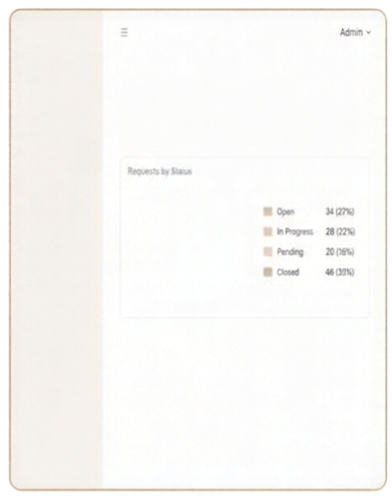
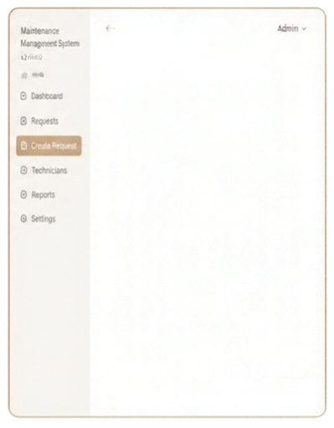
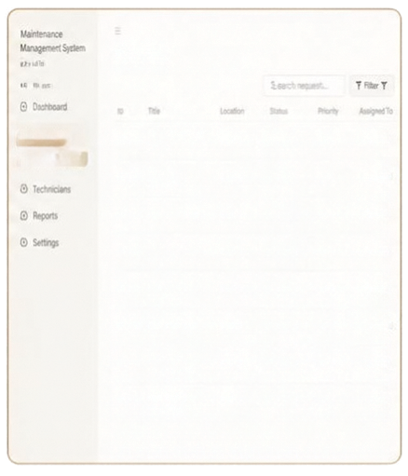
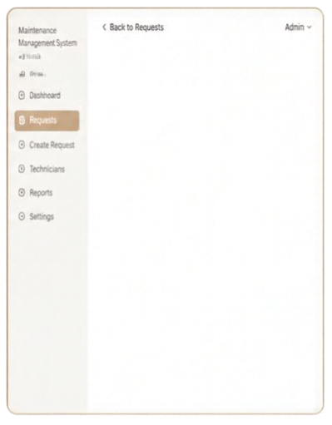










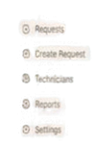
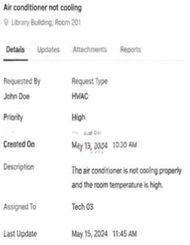


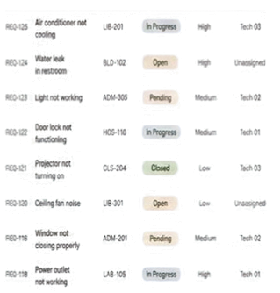






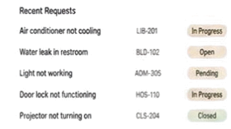

















FROM DASHBOARD TO REQUEST

Slide 7







FROM DATA TO DECISIONS
DATABASE OPERATIONS
REPORTING
CREATE
Pending Requests
READ
Technician Workload
UPDATE
Building Request Count
DELETE
Material Usage
Maintenance Cost
Examples: Request creation, viewing, technician assignment, status updates, work material records
Feedback

Slide 8


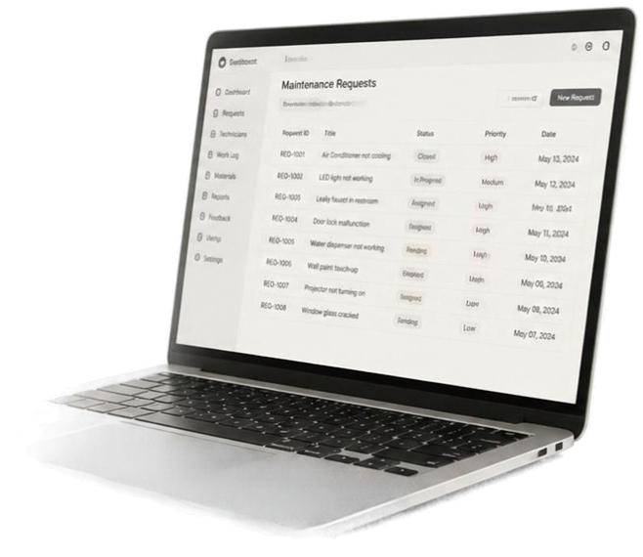












TESTED END TO END
Database Connection
Request Creation
From request creation to closure, the complete workflow was tested with the connected MySQL database.
Request Listing
Technician Assignment
Status Update
Work Log
Material Usage
Request Closure
Feedback
Reports

Slide 9














FROM COMPLAINT TO COMPLETION
REPORT
ASSIGN
REPAIR
TRACK
CLOSE
IMPROVE
Our system transforms campus maintenance
into a structured, trackable and database-driven workflow.
PYTHON + FLASK
MYSQL
13 RELATIONAL TABLES
WORKING WEB PROTOTYPE
THANK YOU
Questions?
Pranav • Purva • Sharanya • Saathvik

